Slide 1

2025 – 2026 Budget

Slide 2
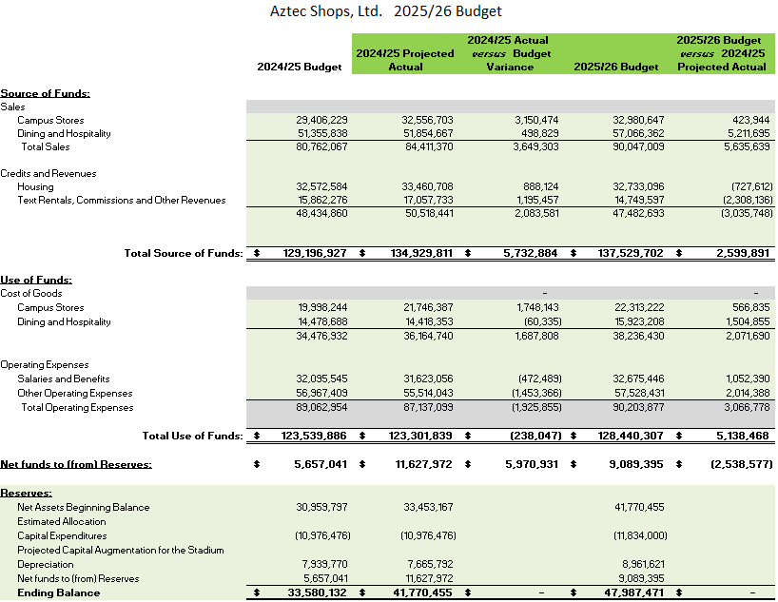
Budget Summary

Slide 3
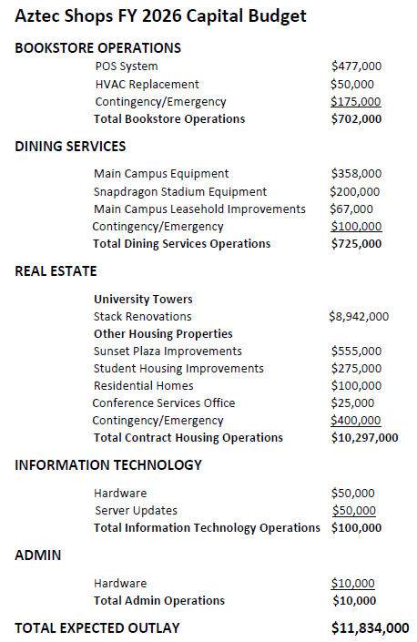
Capital Budget

